Slide 1


12 FACTOR APPS

Slide 2
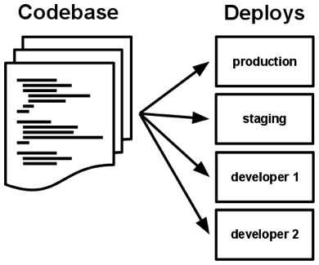
Codebase

Slide 3
2. Dependencies
Ubuntu
Tomcat
Codebase
Deploy
JBoss
?
Cloud Foundry
CentOS
Container

Slide 4
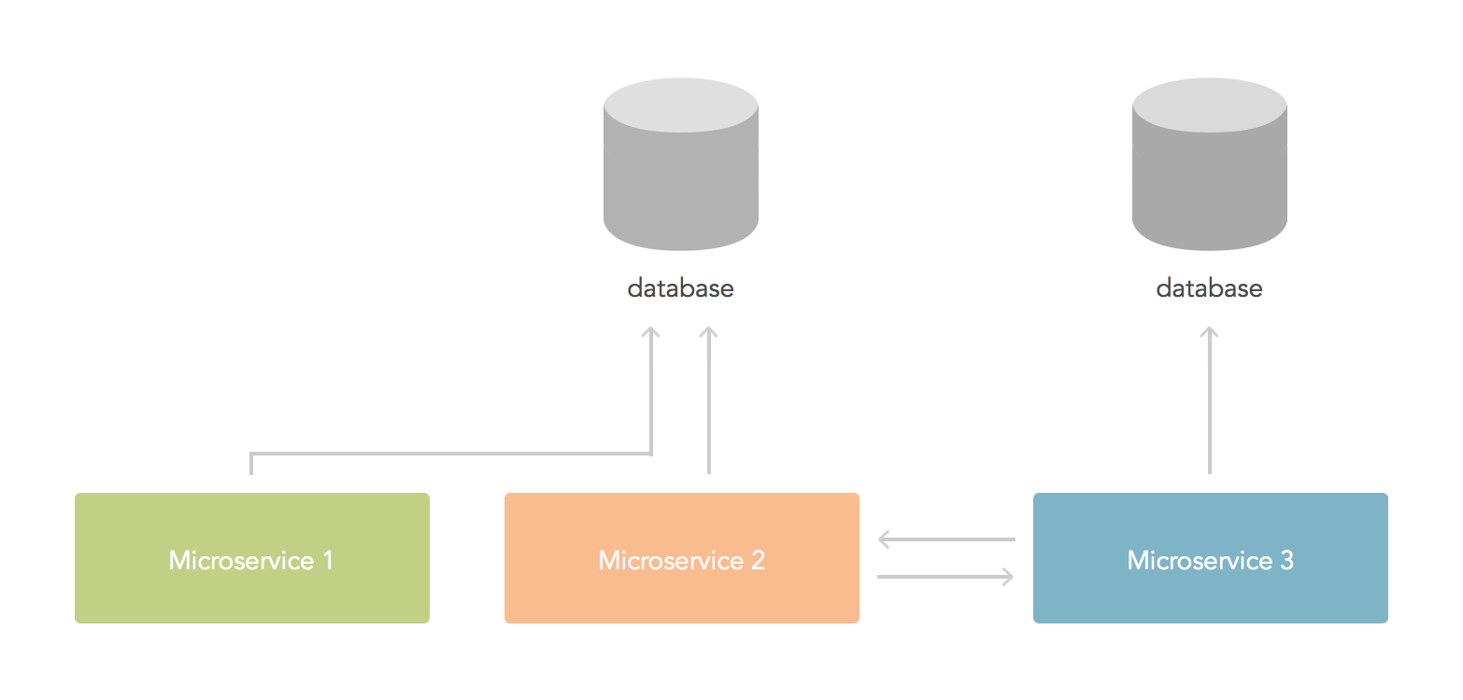
2. Interdependence
?

Slide 5
2. Interdependence - DNS
Server:
@RequestMapping("/name")
private BaseBO getObject(){
return new BaseBO("Name", "My Address", "someaddress@google.com");
}
Client:
@Value(value = "${server.url}")
private String serverUrl;
@RequestMapping("greetings")
private String hello(){
RestTemplate template = new RestTemplate();
BaseBO response = template.getForObject(serverUrl, BaseBO.class);
return "Hello " + response.getName();
}

Slide 6
2. Interdependence - User provided services
Configuration:
cf cups OUR_SERVER -p '{"url":"http://server.hcf.stackato.altoros.com/name"}'
cf bind-service client OUR_SERVER
cf restart client
Client:
@Value(value = "${vcap.services.OUR_SERVER.credentials.url}")
private String serverUrl;
@RequestMapping("greetings")
private String hello(){
RestTemplate template = new RestTemplate();
BaseBO response = template.getForObject(serverUrl, BaseBO.class);
return "Hello " + response.getName();
}

Slide 7
3. Configuration
An Example of Manifest:
Attributes:
buildpack: buildpack_URL
command: START-COMMAND
disk_quota: 1024M
domain(s): example.com
instances: 2
memory: 1024M
host: my-app
no-hostname: true
random-route: true
services
env
--- applications: - name: hello-spring-cloud memory: 512M instances: 1 host: hello-spring-cloud-${random-word} domain: cfapps.io path: target/hello-spring-cloud-0.0.1-SNAPSHOT.jar services: - postgres-service - amqp-service - mongodb-service - redis-service env: SPRING_PROFILES_DEFAULT: cloud

Slide 8
3. Update to configuration
Cloud approach
Update configuration
Push another instance to CF
Alternative solutions
Spring Cloud Config
Archaius

Slide 9
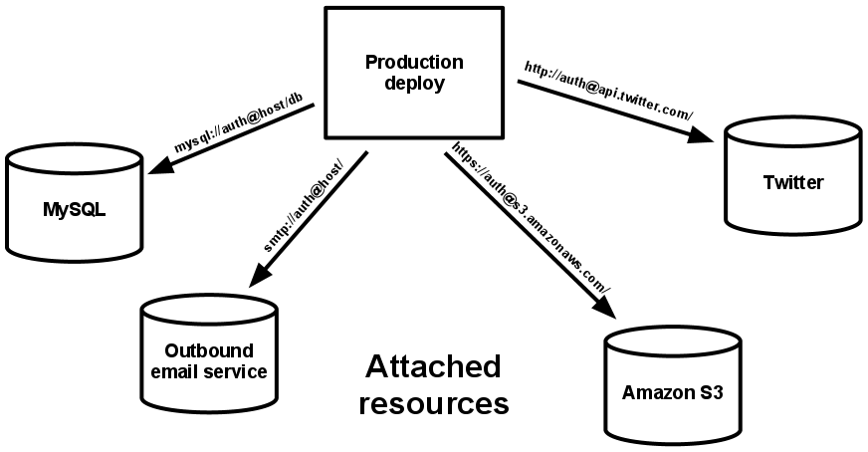
4. Backing services

Slide 10
4. Backing services

Slide 11
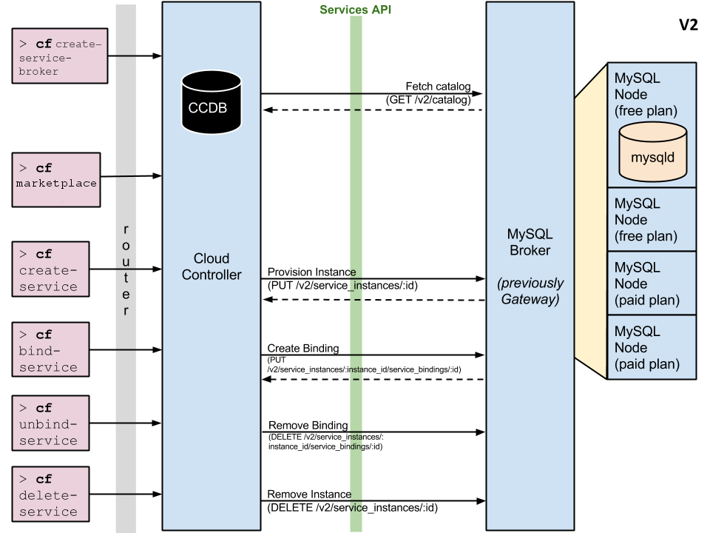
4. Backing services

Slide 12
4. Backing services - autoconfiguration
H2 only
H2 and MySQL in class path
Add spring-boot-starter-cloud-connectors to the classpath
spring.profiles.active=cloud
VCAP_SERVICES={"mysql":[{"name":"mysql",.......

Slide 13
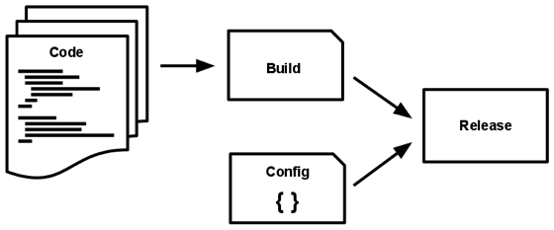
5. Build, release, run

Slide 14
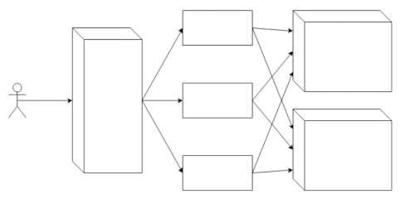
5. Build, release, run
Capistrano
Dev
Jenkins
Fabric
Production
Something else

Slide 15
6. Processes
myApp
Instance 1
Load balancer
Request
myApp
Instance 2

Slide 16
7. Port Binding
Export services via port binding
CF_INSTANCE_PORT

Slide 17
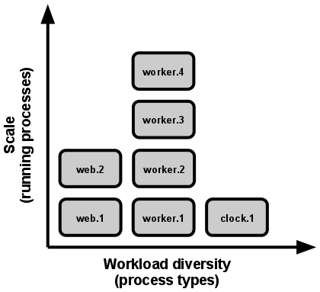
8. Concurrency

Slide 18
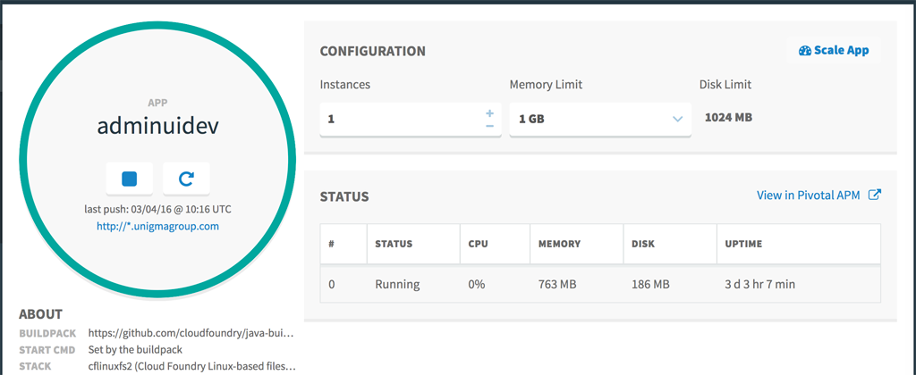
8. Autoscale - Pivotal Web Services

Slide 19
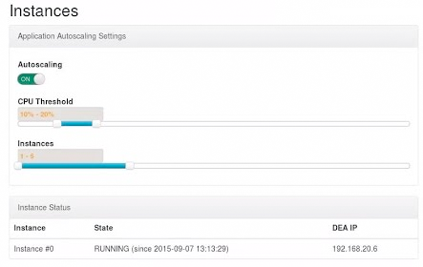
8. Autoscale - HP Helion

Slide 20
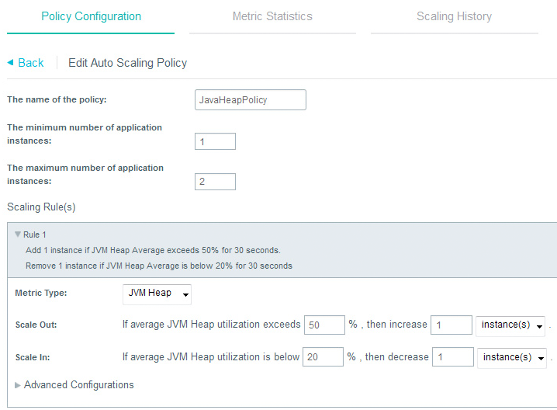
8. Autoscale - IBM Bluemix

Slide 21
9. Disposability
Graceful shutdown
Quick startup
Resilience to Failure

Slide 22
10. Dev/Prod parity - Tools Gap
Production
MySQL
S3
Tomcat
Existing DB schema
Dev environment
SQLite
Memory filesystem
Jetty
DB schema script

Slide 23
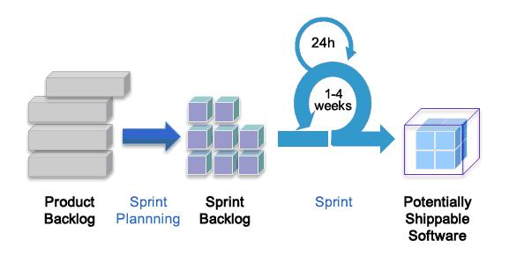
10. Dev/Prod parity - time gap
Traditional app
Weeks
12-factor app
Hours

Slide 24
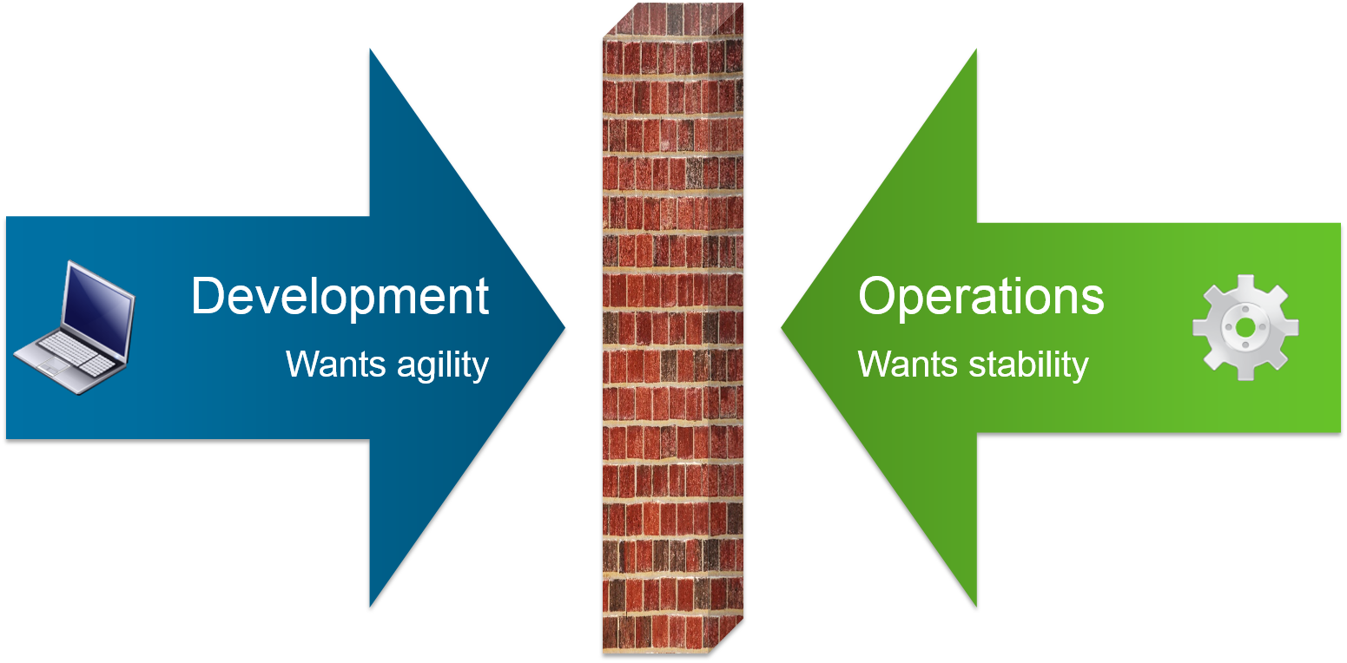
10. Dev/Prod parity - personnel gap
Traditional app
Different people
12-factor app
Same people

Slide 25
12. Admin processes - Liquibase
Simple configuration:
<dependency>
<groupId>org.liquibase</groupId>
<artifactId>liquibase-core</artifactId>
</dependency>
Simple usage:
db/changelog/db.changelog-master.yaml

Slide 26
11. Logs
E-Mail
Proxy
DNS
DHCP
SAMBA
/var/log/exim/mainlog
/var/log/mail.log
/var/log/squid/access.log
/var/log/squid/cache.log
/var/log/syslog
/var/log/named/zone.log
/var/log/syslog
/var/log/samba/log.smbd
/var/log/samba/log.192.168.1.10
ssh
cat
tail
head
grep
gunzip
sed
awk
less

Slide 27
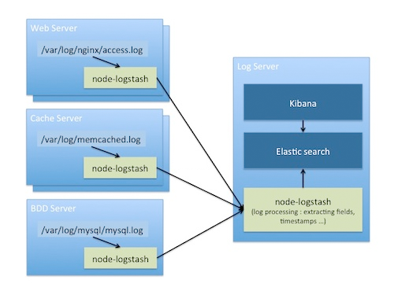
11. Logs - ELK

Slide 28

11. Logs - Logstash
[job=ha_proxy_z1 index=0] 192.168.120.31:56137
[09/Dec/2015:15:20:54.277] https-in~ http-routers/node0
30121/0/1/25/30147 200 377 - - ---- 4/4/1/1/0 0/0 \
"GET /internal/bulk/apps?batch_size=500&format=fingerprint&token={}
HTTP/1.1\"
"@job.name": "ha_proxy_z1",
"@job.index": "0",
"client_ip": "192.168.120.31",
"client_port": "56137",
"accept_date": "09/Dec/2015:15:20:54.277",
"haproxy_monthday": "09",
"haproxy_month": "Dec",
"haproxy_year": "2015”,
"haproxy_time": "15:20:54",
"haproxy_hour": "15",
"haproxy_minute": "20",
"haproxy_second": "54",
"haproxy_milliseconds": "277",
"frontend_name": "https-in~",
"backend_name": "http-routers",

Slide 29
11. Logs - Grok
String:
55.3.244.1 GET /index.html 15824 0.043
grok statement:
%{IP:client} %{WORD:method}
%{URIPATHPARAM:request}
%{NUMBER:bytes} %{NUMBER:duration}
Filters:
Groak
Json
Xml
Multiline
…

Slide 30

11. Logs - Buffer
Applications

Slide 31
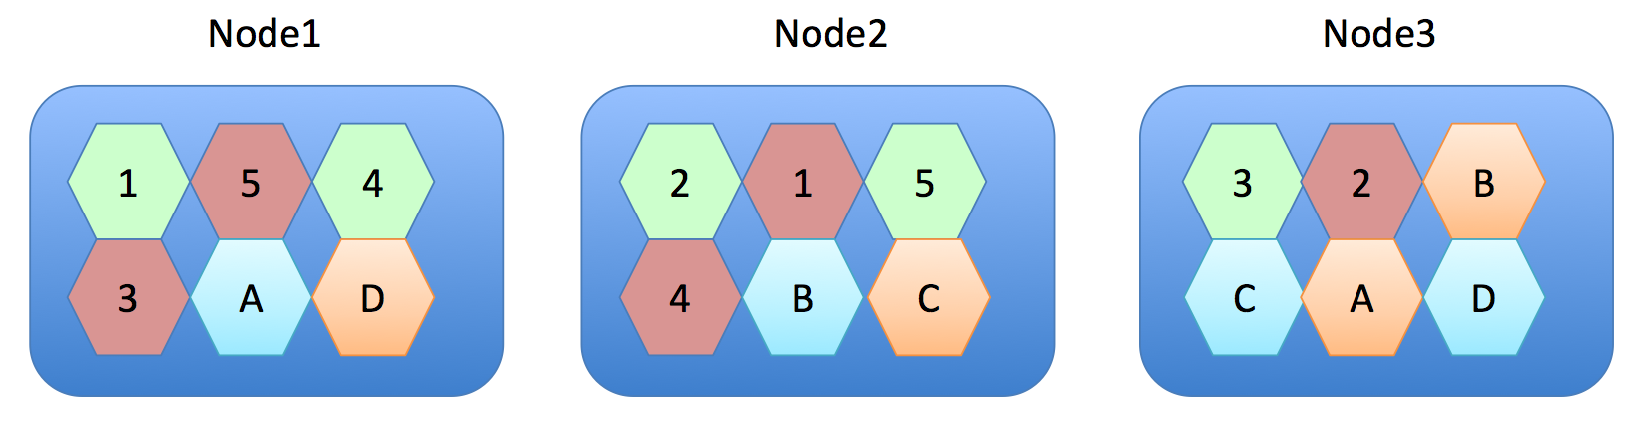
11. Logs - ElasticSearch

Slide 32
11. Logs - Suggestions
Use fastest RAID-0 storage, avoid EBS
Monitor the Queue
Scale parsers when possible
Use small (even spot) parsers
Disable replicas for huge import

Slide 33
12. Admin processes
Do it ONCE
Do it RIGHT
Do it QUICKLY
Keep it SIMPLE

Slide 34
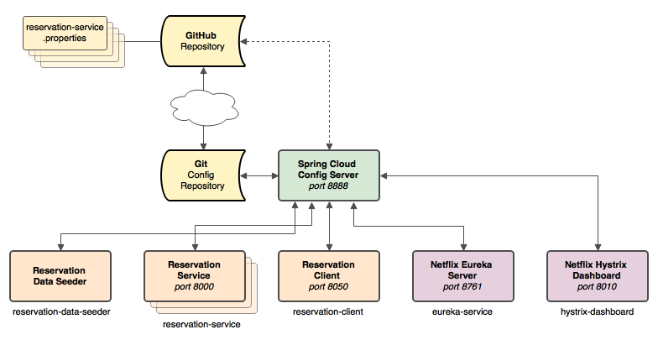
Microservices - Cloud Config

Slide 35
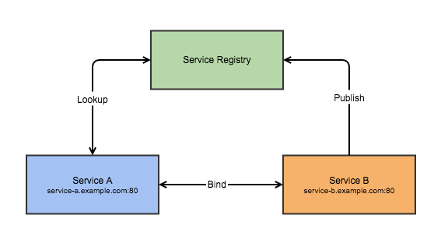
Microservices - Service Discovery

Slide 36
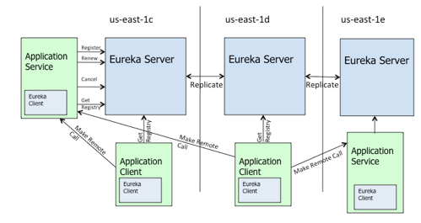
Microservices - Service Registry

Slide 37
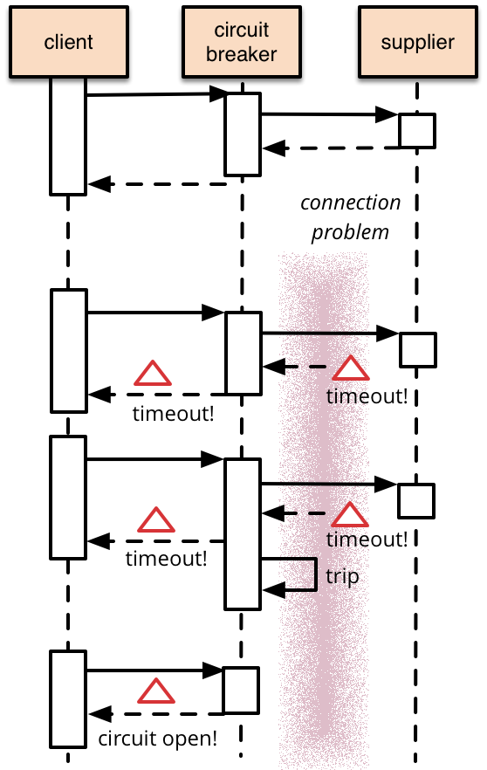
Microservices - Circuit Breaker: Hystrix
Proxy the beans enabling circuit breaker
Enabled by annotation on the method
@HystrixCommand(fallbackMethod=„”)
public Article getArticle(String id) {
// call external system
}
Fallback can be provided
Hystrix metrics stream: /hystrix.stream
Hystrix Dashboard

